Slide 1

PrePlate: An Agentic AI-Based Campus Food Pre-Ordering System
SOA Project Review-1
27/8/26
2:00 PM
 | Under the Guidance of Ms. Venkateshwari Ketineni Associate Professor, Department of Computer Science and Engineering, KLH CSE Bowrampet Campus
Team Members Suhitha Chalasani – 2420030444 Kapilavai Hamsini – 2420030398 Masetti Manasvini - 2420030475

Slide 2
Outline of Project Work
Focus
Introduction
Literature Survey
Challenges
Research Objectives
Conclusion & Future Work
References
Publications Details

Slide 3
Problem Statement
Long queues and waiting time: Campus food counters become crowded during peak hours, causing students to spend valuable time waiting for their orders.
Difficulty in food selection: Students may struggle to choose suitable food based on their preferences, budget, availability, and time constraints.
Limited intelligence in existing systems: Traditional food-ordering systems mainly support basic ordering and tracking, with limited personalization and queue prediction.
Inefficient pickup and coordination: Lack of intelligent coordination between students, orders, and cafeteria staff can lead to unnecessary waiting and inefficient food preparation.

Slide 4
Objectives
Develop an intelligent pre-ordering system that understands student requests through natural language.
Provide personalized recommendations based on food preferences, budget, availability, preparation time, and previous orders.
Predict waiting time and recommend pickup slots based on current orders, kitchen workload, and the student's available time.
Improve cafeteria coordination through order-status tracking, notifications, feedback analysis, and multiple AI agents working through SOA.

Slide 5
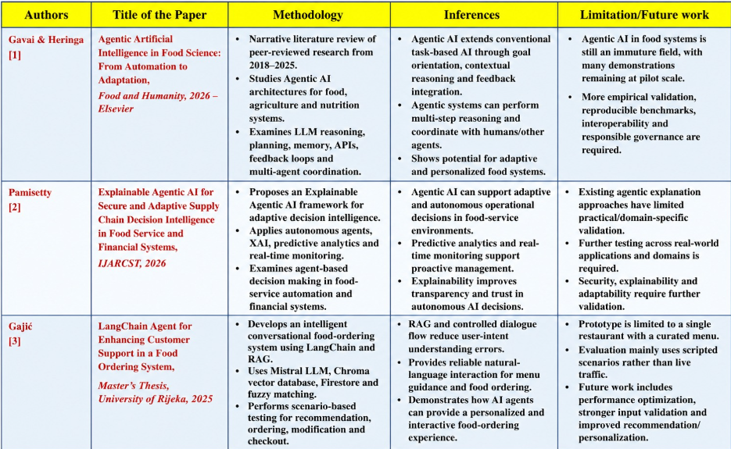
Literature Survey

Slide 6
Problem Gap Identification
Gavai & Heringa (2026) – Agentic AI: Food-domain Agentic AI is still largely conceptual/pilot-scale, requiring more real-world validation.
Gajić (2025) – LangChain + RAG + Mistral LLM: Supports intelligent food ordering, but is limited to a single restaurant and lacks queue/pickup optimization.
Pamisetty (2026) – Explainable Agentic AI: Supports adaptive food-service decisions, but has limited practical/domain-specific validation.
Missing Integration: Existing works do not combine natural-language ordering + personalized recommendation + queue prediction + smart pickup + kitchen coordination in one system.
PrePlate: Bridges these gaps using coordinated AI agents + ML-based queue prediction + SOA/Microservices for a campus-specific food pre-ordering system

Slide 7
Innovation, Creativity, and Novelty
Agentic AI: Multiple specialized agents collaborate to handle ordering, recommendations, queue prediction, and feedback.
Natural-Language Ordering: Students can describe what they want instead of manually browsing the menu.
Context-Aware Pickup: Pickup time is suggested using queue conditions, preparation time, and the student's available time.
SOA-Based Integration: AI agents and independent services communicate through REST APIs for a modular and scalable system.

Slide 8
Feasibility and Project Plan
Technical: Uses established technologies such as Gemini, LangGraph, Whisper, Scikit-learn, and Hugging Face.
Operational: Directly addresses real campus cafeteria problems and supports both students and staff.
Scalable: Independent services can be developed, tested, and integrated separately.
Measurable: Performance can be evaluated using recommendation relevance, queue prediction error, reliability, and waiting-time reduction.

